Slide 1

SELDEW
Save Every Last Drop to End Waste
Nathan (Lead)
Smarajit (Databas)
Leo (Python)
Johnny (App Dev)

Slide 2
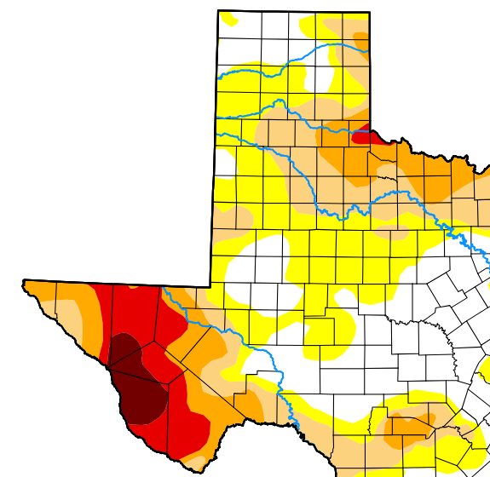
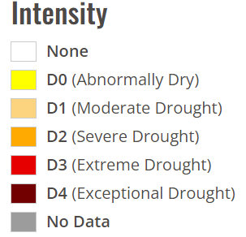


The Problem
Water conservation
Major Droughts due to weather and water use
Local Resources running low
[2]

Slide 3

The Cause
Households on average waste around 90 Gallons per day![3]
(32,400 Gallons/year)

Slide 4

Our Solution
The SELDEW App
Save Every Last Drop to End Waste
Tracks personal and household water usage to reduce waste

Slide 5
How It Works
Senses water usage and starts a timer
Tracks who is using the water (simulated)
Sends water use log to database(simulated)
User, ammount used, location, day
Visualise usage to monitor waste
Python application organizes and plots data
User friendly app reveals water spending habits
Shows user their goals and their household use

Slide 6
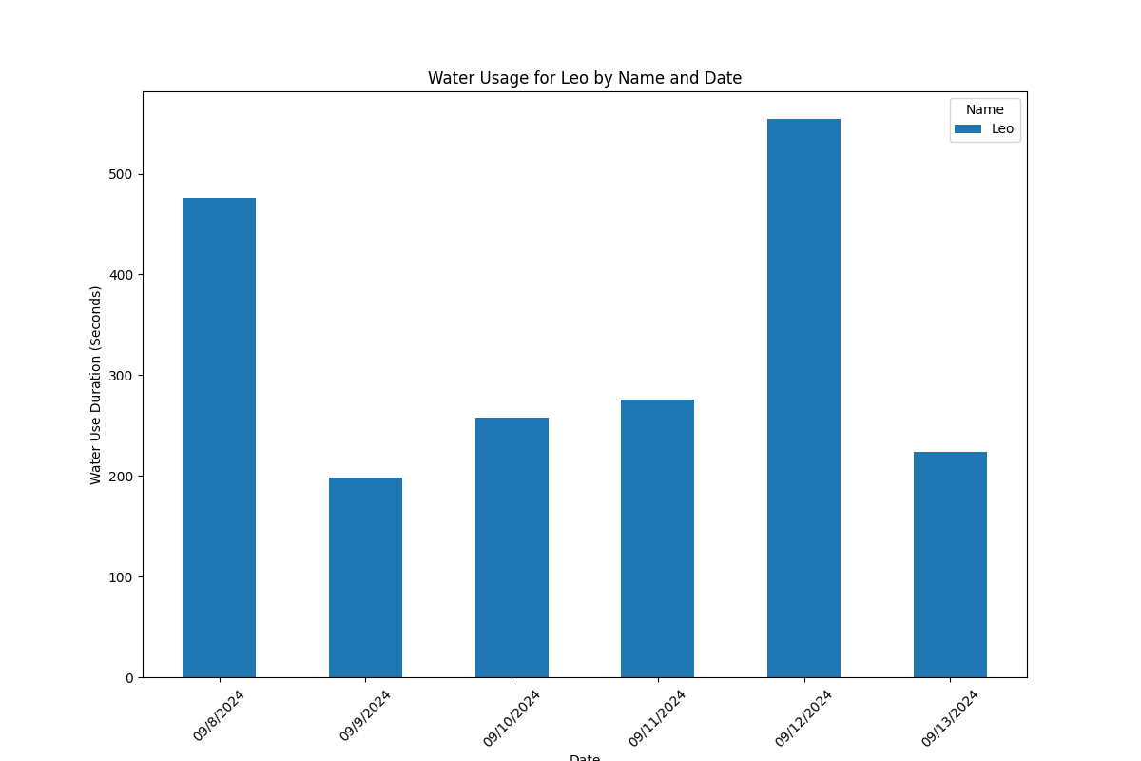
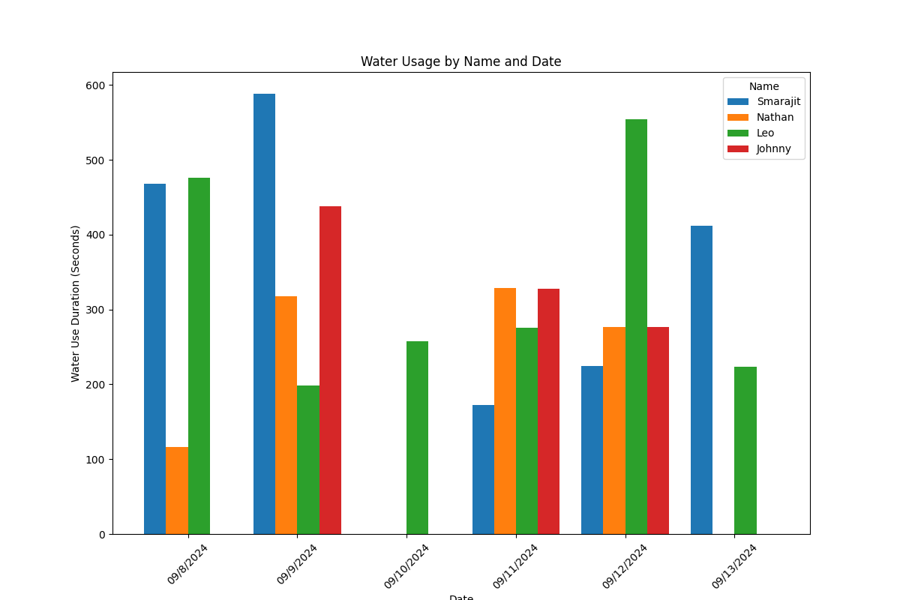
The Concept
Live Demo...

Slide 7
Future Implementation & Scalability
Connectivity
Wireless communication
Database connected
Automatic calculation
Sensor accuracy
Fluid sensors
User Detection
BLE prox detection
Household accounts
Compare household users
Expand from home to businesses or city wide to manage usage on a larger scale
Smart Cities

Slide 8
Sources and Works Cited
Water Data For Texas
Drought Map of Texas
Average Household Waste Source
https://docs.arduino.cc/tutorials/uno-r4-wifi/led-matrix/
https://docs.sunfounder.com/projects/umsk/en/latest/02_arduino/uno_lesson23_ultrasonic.html
https://github.com/sstaub/Timer

